Slide 1

Secure Password Generator (CLI)
A Cryptographically-Secure Python Command-Line Tool

Slide 2





Project Overview
Python-Based CLI Tool
Cryptographic Security
Leverages Python for cross-platform compatibility and ease of development.
Utilizes Python's secrets module for generating cryptographically strong random numbers.
Cross-Platform Compatibility
Zero External Dependencies
Functions across Linux, macOS, and Windows terminals, providing broad accessibility.
Operates independently, requiring no additional libraries for installation and execution.

Slide 3


Why It's Needed
Weak Passwords Lead to Security Risks
Weak passwords cause compromised accounts and data breaches. Robust password generation is essential.
Users Often Reuse or Manually Create Predictable Passwords
Users often reuse or create predictable passwords for convenience. This dramatically increases vulnerability.
A CLI Tool Allows Fast Generation Directly from Terminal
Useful for Developers, Sysadmins, Security-Conscious Users
Provides immediate, on-demand password creation without leaving the command-line environment.
Tailored for technical users who prioritize security and efficiency in their workflows.

Slide 4
Key Features: Comprehensive Customization
Fully Customizable Password Generation
Supports Lowercase, Uppercase, Digits, Symbols
Tailor password complexity and character sets precisely, including length and character inclusion.
Choose from lowercase, uppercase, digits, and symbols to increase password strength.
Custom Symbol Sets
Exclude Characters & Remove Ambiguous Characters
Define custom special characters for greater control over password composition.
Exclude specific characters and remove ambiguous ones (e.g., O/0, I/l/1) for better readability.
Enforce At Least One of Each Chosen Character Class
No-Repeat Mode & URL-Safe Mode
Guarantee passwords contain a mix of selected character types, meeting complex requirements.
Generate passwords with no duplicate characters (no-repeat mode) or URL-friendly characters (URL-safe mode).
Prefix and Suffix Support
Generate One or Many Passwords
Add strings at the beginning or end of passwords for branding or identification.
Produce single passwords or batches of credentials with one command, ideal for bulk account creation.

Slide 5
Security Features
Uses secrets.choice() and secrets.randbelow()
Avoids Python's Insecure random Module
Employs Python's secrets module for cryptographically secure random number generation.
Avoids Python's `random` module, which is not suitable for cryptography.
Supports Entropy Calculation
Clipboard Integration for Secure Transfer
Measures password randomness and unpredictability. Allows users to assess password strength.
Copies passwords to the system clipboard using native tools (wl-copy, xclip, pbcopy). Minimizes exposure and manual errors.

Slide 6



Output Formats: Adaptable and Convenient
JSON (JavaScript Object Notation)
Structured data output, ideal for programmatic parsing and integration.
Plain Text
Simple, unformatted output for quick viewing.
CSV (Comma-Separated Values)
Tabular data output, perfect for spreadsheets and databases.

Slide 7
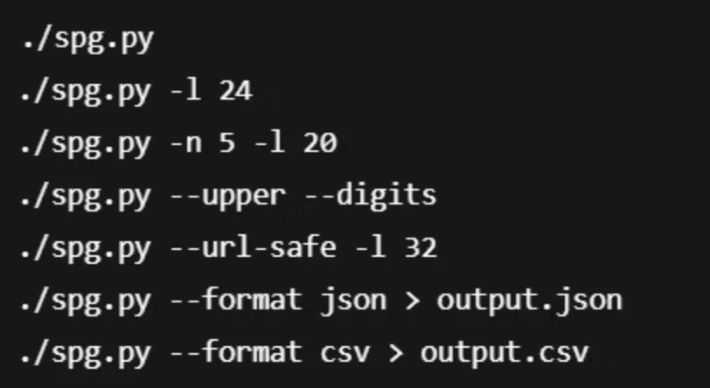
Example Commands
Generate a basic 12-character password:
passwordgen -l 12
Generate a 16-character password with symbols and no ambiguous characters:
passwordgen -l 16 -s --no-ambiguous
Generate 5 passwords, 20 characters long, with a custom symbol set:
passwordgen -n 5 -l 20 -c "!@#$%^&*"

Slide 8




How It Works Internally
Ensures Required Classes and Constraints
Builds Character Pool
A pool of eligible characters is created based on user options.
The tool verifies all specified requirements are met, such as including diverse character types.
Generates Requested Number of Passwords
Uses Secure Shuffle Algorithm
A cryptographically secure shuffling algorithm rearranges the character pool for randomness and to prevent pattern detection.
Passwords are constructed from the shuffled pool. The process repeats if multiple passwords are requested.

Slide 9

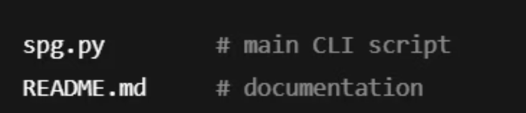
Project Structure
1
Root Directory
Main application files, configuration, and documentation.
2
Docs/
Usage instructions, examples, and contributing guidelines.
3
Tests/
Unit and integration tests for code quality and functionality.

Slide 10

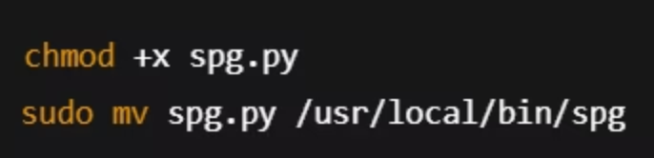
Installation
Getting started with the Secure Password Generator is quick and straightforward, allowing you to begin generating strong passwords in minutes.
01
02
03
Clone the Repository
Navigate to Project Directory
Run the Tool
Clone the project repository from GitHub to your local machine.
Change your current directory to the newly cloned project folder.
Execute the Python script directly from your terminal.
git clone [repository-url]
cd secure-password-generator
python passwordgen.py --help

